Slide 1
Project Name
Kickoff Meeting
Month year

Slide 2
Project Background
Project overview
Project schedule
Lessons learned from previous projects
Processes that will be used to manage this project
Team roles & responsibilities
Team culture
Key stakeholders
Known project risks
Project constraints
Critical success factors
Governance

Slide 3
Project Overview
The primary goals of this project are:
Goal 1
Goal 2
Goal 3

Slide 4
Project Scope
In Scope
Requirements gathering
Creation of RFP and evaluation of bids
Test plans
Out of Scope
Interfaces to search engines
New financial transaction types
Training external teams

Slide 5
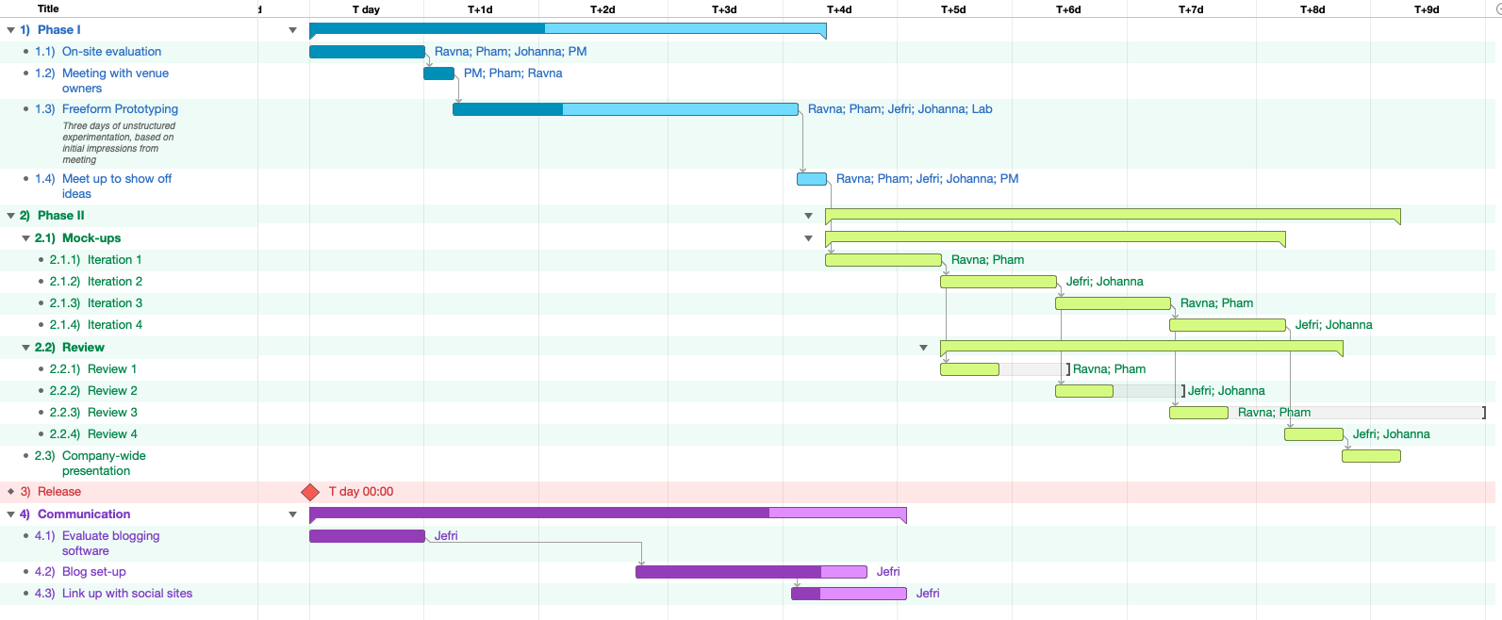
Project Schedule

Slide 6
Lessons Learned from Previous Projects
Lesson 1
How we will apply that
Lesson 2
How we will apply that
Lesson 3
How we will apply that

Slide 7
Project Management Processes
Processes we will use to deliver this project:
Schedule
Scope
Budget
Risk
Communications
Procurement

Slide 8
Team Roles & Responsibilities
Business Analysts
Confirm and document requirements
System testing
Training business users
Architects
Designing a solution that aligns with corporate standards and guidelines
Developers
Developing a solution specified by business requirements and aligned with the design provided by the Architects

Slide 9
Stages of Team Development

Slide 10
Desired Team Culture
We will work as a collaborative team
Ask lots of questions
Take initiative
Come with solutions to problems
Work hard celebrate team wins

Slide 11
Key Stakeholders
Project Sponsor
FOIP coordinator
Media consultant
Business team 1
Business team 2

Slide 12
Known Risks
Effort required to gain consensus on requirements
Significant pressure to expand scope
Complexity of interfaces is significant
Regulatory approval for acquiring needed technology

Slide 13
Project Constraints
Stage 1 must be complete by month day, year
Budget can not exceed $125,000
Scope must include all items documented in requirements documentation

Slide 14
Critical Success Factors
Requirements documentation must be thorough and complete
Extensive communication with the business teams
This project will require extensive prototyping and will require an agile approach
Testing must be thorough. Automated testing is likely needed

Slide 15
Governance
Steering Committee
Architecture Team
Project Manager
Business Analysts
Architects
Project Sponsor
Change Advisory Board
Developers
Testers
Legal Advisor
Media Consultant

Slide 16

Discussion

